Slide 2

Mars OS
Rutwik Stuff Corp.

Slide 3
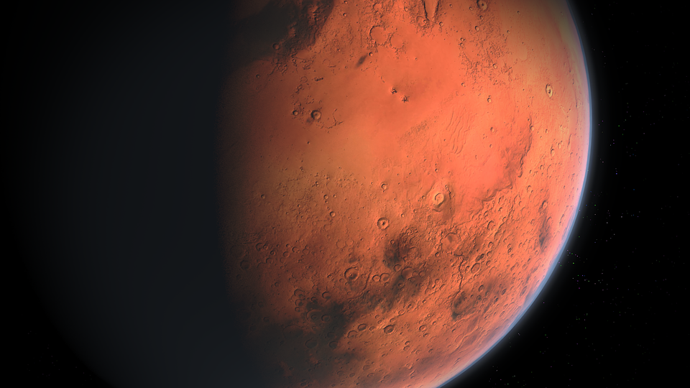

RutwikasZeb
Sign in
Mars OS 1.0

Slide 4








Trash
About
Firefox
VMware
This PC
OneNote
Mars 1.0 is not activated Build 120.32 (RTM)
5:22pm 04/19/2024

Slide 5
Trash
About
Mars OS 1.0 is ending support
Sorry, but this is important
Firefox
VMware
Mars OS 1.0 is ending support on April 19, 2024, which means it will no longer get any more updates, including security updates. Please upgrade to a newer operating system.
This PC
Don’t show again
OneNote
Ok
Mars 1.0 is not activated Build 120.32 (RTM)
5:22pm 04/19/2024

Slide 6
Trash
About
Firefox
VMware
This PC
OneNote
Mars 1.0 is not activated Build 120.32 (RTM)
5:22pm 04/19/2024

Slide 7
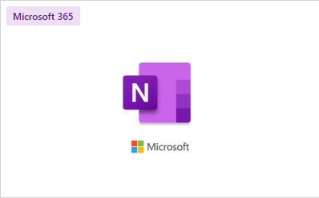
Trash
About
Firefox
VMware
This PC
OneNote
Mars 1.0 is not activated Build 120.32 (RTM)
5:22pm 04/19/2024

Slide 8
Trash
About
Error Code: 1373839 Mars OS 1.0 is not supported anymore, so OneNote cannot launch.
Firefox
VMware
This PC
OneNote
Mars 1.0 is not activated Build 120.32 (RTM)
5:22pm 04/19/2024

Slide 9
Trash
About
Firefox
VMware
This PC
OneNote
Your computer is not safe.
Click to learn more
Mars 1.0 is not activated Build 120.32 (RTM)
5:22pm 04/19/2024

Slide 10

Mars OS Security Centre
Trash
About
Your computer is not protected
Firefox
VMware
Check for Updates
Update Mars OS
Online Blocking
Web Protection: ON Virus Protection: ON Security Updates: OFF (Turn On) Mars Inhabit (Firewall): ON ZEB Sync: OFF (Turn On)
This PC
OneNote
Mars 1.0 is not activated Build 120.32 (RTM)
5:22pm 04/19/2024

Slide 11
Mars OS Security Centre
Trash
About
Checking for updates
Firefox
VMware
Cancal
This PC
OneNote
Mars 1.0 is not activated Build 120.32 (RTM)
5:22pm 04/19/2024

Slide 12
Mars OS Security Centre
Trash
About
Checking for updates
Firefox
VMware
Mars OS 1.0 has ended support, so you will not get anymore updates.
This PC
Back
OneNote
Mars 1.0 is not activated Build 120.32 (RTM)
5:22pm 04/19/2024

Slide 13
Mars Web – Version 1.02
Trash
https://marsos.rutwikstuff.rn/1/online-blocking/status
About
Mars OS 1.0
Firefox
Mars OS 1.0 does not get anymore updates because it has ended support, so the servers are down now.
VMware
This PC
OneNote
Back
Mars 1.0 is not activated Build 120.32 (RTM)
5:22pm 04/19/2024

Slide 14
Mars Web – Version 1.02
Trash
https://marsos.rutwikstuff.rn/zebsync
About
Mars OS 1.0
Firefox
Zeb Sync
VMware
Oops! Looks like the Zeb Sync Servers are down, please try again later.
This PC
OneNote
Back
Mars 1.0 is not activated Build 120.32 (RTM)
5:22pm 04/19/2024

Slide 15
Mars OS Security Centre
Trash
About
Turn on Security Updates
Firefox
VMware
Mars OS 1.0 has ended support, so you will not get anymore updates.
This PC
Back
OneNote
Mars 1.0 is not activated Build 120.32 (RTM)
5:22pm 04/19/2024

Slide 16
Trash
About
Firefox
VMware
This PC
OneNote
Mars 1.0 is not activated Build 120.32 (RTM)
5:22pm 04/19/2024

Slide 17


OneNote
Trash
About
Firefox
About
Firefox
VMware
This PC
Volume
45%
OneNote
RutwikasZeb
Mars 1.0 is not activated Build 120.32 (RTM)
5:22pm 04/19/2024

Slide 18
Shutting Down
Mars OS 1.0

Slide 19
It is now safe to turn off your computer.
[Turn on]

